Slide 1



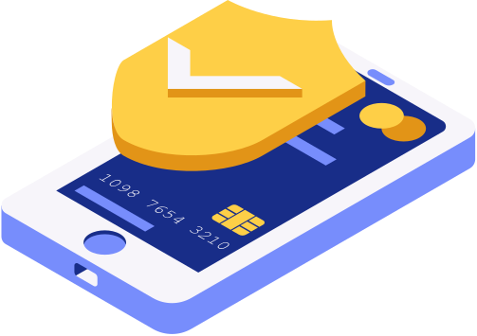
INTRODUCTION TO
SOFTWARE ENGINEERING

Slide 2


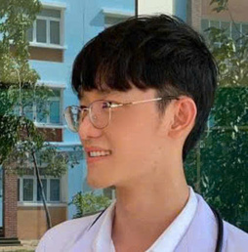
TEAM
MEMBER
Nguyễn Trung Việt
Lê Bùi Quốc Vũ
ID: 24880074
24880077
Lưu Trung Tín
ID 24880061
GROUP PRESENTATION

Slide 3
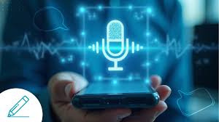
PRESENTATION
This software is designed to enhance users’ English communication skills by providing a direct interactive environment that simulates one-on-one conversations with the system, implemented as either a web platform or a mobile application. It enables users to communicate in English using speech-to-text technology combined with a large language model (LLM) similar to ChatGPT, allowing the system to generate continuous and meaningful dialogues that support effective language learning.
TOPIC
English Learning Software
GROUP PRESENTATION

Slide 4

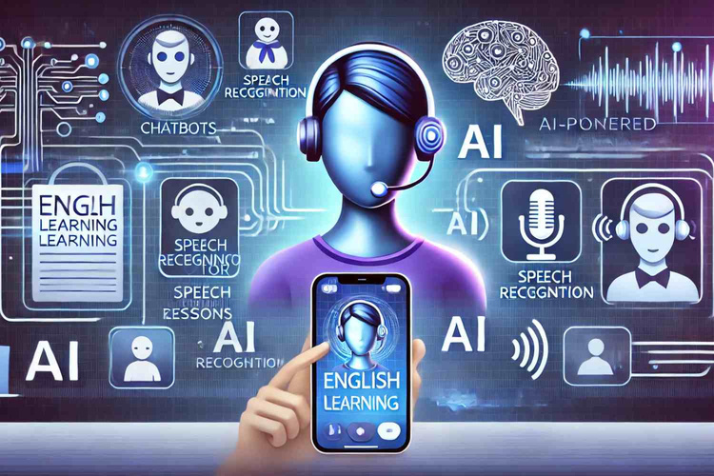

SOFTWARE
OBJECTIVES
This software aims to provide a highly interactive English learning platform that helps users improve their language skills through modern technology and realistic interaction.
GROUP PRESENTATION

Slide 5

Speech Recognition:
Users read English sentences aloud, and the system uses a speech recognition API to convert the audio into text. Users can edit the text if needed and then submit it back to the system using the "Send" button.
MAIN
Text-to-Text Interaction:
The system receives the edited text and uses an API or a large language model to analyze it and respond in English, appropriate to the context of the conversation. It provides suggested follow-up questions to encourage the dialogue and offers a text-to-speech function so that users can hear the correct pronunciation.
FUNCTIONS
GROUP PRESENTATION

Slide 6

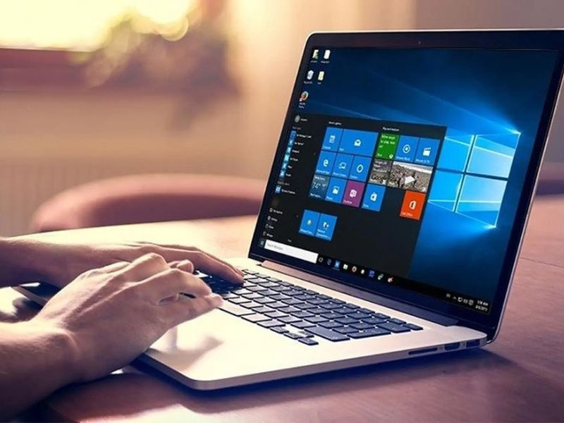

Auto Mode
Continuous one-on-one conversation without the need to press the "Send" button.
ADVANCED
Vocabulary Support
FEATURES
If users encounter difficulties with vocabulary or pronunciation, they can use the integrated dictionary feature in the application or access Google Translate or a similar API to translate and learn new words.
GROUP PRESENTATION

Slide 7

KEY
TECHNOLOGIES
English Communication Web Application Integrated with APIs such as speech-to-text and text-to-speech from providers.
Designed with a user-friendly interface, easy navigation, and ensuring a seamless learning experience.
GROUP PRESENTATION

Slide 8

APPLICATION
Our English learning app offers a highly interactive and immersive experience that allows users to practice speaking, listening, and understanding English in real-time. By integrating cutting-edge technologies like speech-to-text, text-to-speech, and AI-powered conversation models, the app simulates natural one-on-one dialogues, helping users build confidence and fluency. With personalized feedback, vocabulary support, and engaging exercises, it transforms language learning into a fun, efficient, and practical experience—anytime, anywhere.
CAPABILITIES
GROUP PRESENTATION

Slide 9


Q
Any Question For US ?
You can ask directly right now or send your question to viet.nt123456@gmail.com, and we will respond as soon as possible.
AND A
GROUP PRESENTATION

Slide 10


THANK
+123-456-7890
YOU!
viet.nt123456@gmail.com
GROUP PRESENTATION

